Slide 1
IFN663 Enterprise Architecture Lecture 4, 5 and 6: Enterprise Architecture Development Method: Archimate
Alistair Barros
Faculty of Science & Engineering
Queensland University of Technology
QUT Gardens Point Campus, 11th Aug, 18th August & 25th August 2015

Slide 2
Objectives
Understand how enterprise architecture is structured to support business and IT planning
Understand a specific EA method: Archimate (recommended for TOGAF)
Understand modelling at business, IT application and IT infrastructure layers through Archimate

Slide 3

Agenda
Different aspects and layers of enterprise architecture
Archimate business layer modelling
Archimate IT application layer modelling
Archimate IT infrastructure layer modelling
Notes:
Archimate is a specific method of EA

Slide 4
From Business Strategy to IT Solutions
Business
Strategy
Goals, Policies, Business
Ecosystem, Business Scopes
Enterprise
Business Architecture
Have learned in last 2 lectures
This lecture and the next 2
Business Scopes to Business Capabilities
Enterprise Alignment Architecture
Business Capabilities to business-to-IT alignment models
Business Process Management
Business process models
Solutions
IT Solutions
Solution architecture models

Slide 5
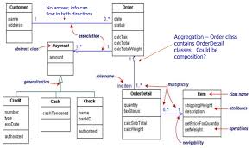
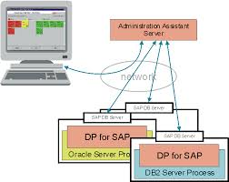
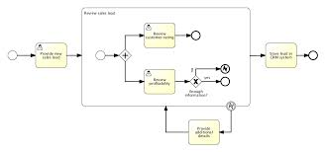
Recap: EA to Solutions
Enterprise Architecture
Solution Architectures
BUSINESS PLANNING:
Capability Map
EA Business-to-IT Models:
Archimate
SOLUTION PLANNING
Detailed
data
analysis
Software
Design/
config
High-level
Process
map
Data models
Integrated
scenarios
Technical
analysis
BUSINESS PLANNING:
Value Streams
Detailed
process
analysis
Business Process models
Notes:
Focus on the middle section which is to turn EA business from the last 2 lectures into IT models using Archimate method
Solution is to pick one of those in the middle to analyze and detail it

Slide 6
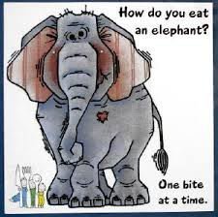
How to approach EA?
EA supports different organizational aspects (e.g. capabilities, processes, services, information, resources)
EA covers business and IT concerns, with their distinct specializations
EA supports diverse planning activities and personnel – from transforming business to coordinating and renewing IT
EA development is driven by different
business/IT priorities

Slide 7
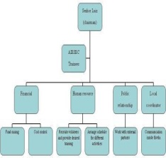

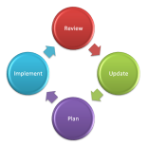


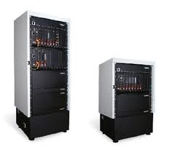
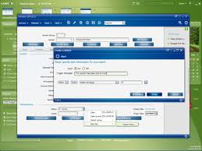
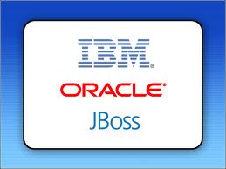
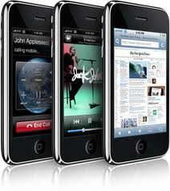

Business and IT Aspects and Dependencies
Business level
Business
services
Business
process
Organisation
structure
Business
products
Business
information
Aspects
Layers
Dependencies
IT level
End-user
devices
Software
application
Computing
infrastructure
IT Platform

Slide 8
Key layers in enterprise architecture
Business layer
How an organisation structures itself; interacts with customers for product and service delivery; operates internally through business processes and externally with business partners
Application layer
Which software applications are used to support the business; how software is structured; and how it interacts internally with different parts and externally with other software
Technology layer (a.k.a. IT Infrastructure layer)
What middleware platforms and hardware are used to support software applications; and how they interact
Several examples illustrating Archimate in this presentation have been drawn from: M. Lankhorst et al. Enterprise Architecture at Work: Modelling, Communication and Analysis (2nd Ed). Springer-Verlag, 2009

Slide 9
Modelling domains of different aspects
Layers
Product
domain
Business
Organisation
domain
Process
domain
Information
domain
Application domain
Data
domain
Application
Technical infrastructure domain
Technology
Aspects
Resource
Behavior
Structure
Notes:
How to consider EA layers through different aspects

Slide 10
EA Methods
Provides ways of capturing the different aspects, dependencies, layers and views of enterprise architectures
Comprises a number of modelling techniques and languages specialized for these different concerns
A modelling technique/language supports modelling concepts and procedures, focuses on a single aspect:
E.g. Business Process Modelling Notation (BPMN) for business processes
Unified Service Description Language (USDL) for services
Notes:
Process Modelling Technique
Activity (Rectangular)
Business or Data Object (Dotted Rectangular)
Activity Flow (Arrow)
Data flow (Dotted Arrow)

Slide 11
EA Methods (cont’d)
Integrates different techniques through an underlying set of core concepts and rules, i.e. an integrated meta-model
General approaches:
Peer-to-peer EA method: Integration of different techniques, each supporting an aspect across both business and IT layers.
Vertical EA method: Single technique supporting capture of different aspects across business and IT layers, with reference to other techniques for specialised focus on particular aspects
Hundreds of EA methods proposed over last 20 years
Notes:
EA methods
Peer-to-peer EA (many techniques to support 1 aspect)
Vertical EA (1 technique to support many aspects)

Slide 12
Peer-to-Peer EA Method: Zachman Framework
abstractions
DATA
What
FUNCTION
How
NETWORK
Where
PEOPLE
Who
TIME
When
MOTIVATION
Why
perspectives
List of Things -
Important to the Business
List of Processes -
the Business Performs
List of Locations -
in which the Business Operates
List of Organizations -
Important to the Business
List of Events -
Significant to the Business
List of Business Goals and Strategies
SCOPE
Planner
contextual
Entity = Class of
Business Thing
Function = Class of
Business Process
Node = Major Business
Location
People = Class of People and
Major Organizations
Time = Major Business Event
Ends/Means=Major Business
Goal/Critical Success Factor
ENTERPRISE
MODEL
Owner
e.g., Semantic Model
e.g., Business Process Model
e.g., Logistics Network
e.g., Work Flow Model
e.g., Master Schedule
e.g., Business Plan
conceptual
Entity = Business Entity
Rel. = Business Relationship
Process = Business Process
I/O = Business Resources
Node = Business Location
Link = Business Linkage
People = Organization Unit
Work = Work Product
Time = Business Event
Cycle = Business Cycle
End = Business Objective
Means = Business Strategy
SYSTEM
MODEL
Designer
e.g., Logical Data Model
e.g., Application Architecture
e.g., Distributed System
Architecture
e.g., Human Interface
Architecture
e.g., Processing Structure
e.g., Business Rule Model
logical
Entity = Data Entity
Rel. = Data Relationship
Process.= Application Function
I/O = User Views
Node = IS Function
Link = Line Characteristics
People = Role
Work = Deliverable
Time = System Event
Cycle = Processing Cycle
End = Structural Assertion
Means =Action Assertion
e.g., Physical Data Model
e.g., System Design
e.g., Technical Architecture
e.g., Presentation Architecture
e.g., Control Structure
e.g., Rule Design
TECHNOLOGY
CONSTRAINED
MODEL
Builder
physical
Entity = Tables/Segments/etc.
Rel. = Key/Pointer/etc.
Process= Computer Function
I/O =Data Elements/Sets
Node = Hardware/System
Software
Link = Line Specifications
People = User
Work = Screen/Device Format
Time = Execute
Cycle = Component Cycle
End = Condition
Means = Action
e.g. Data Definition
e.g. Program
e.g. Network Architecture
e.g. Security Architecture
e.g. Timing Definition
e.g. Rule Specification
DETAILED
REPRESEN-
TATIONS
Subcontractor
out-of-context
Entity = Field
Rel. = Address
Process= Language Statement
I/O = Control Block
Node = Addresses
Link = Protocols
People = Identity
Work = Job
Time = Interrupt
Cycle = Machine Cycle
End = Sub-condition
Means = Step
FUNCTIONING
ENTERPRISE
DATA
Implementation
FUNCTION
Implementation
NETWORK
Implementation
ORGANIZATION
Implementation
SCHEDULE
Implementation
STRATEGY
Implementation

Slide 13
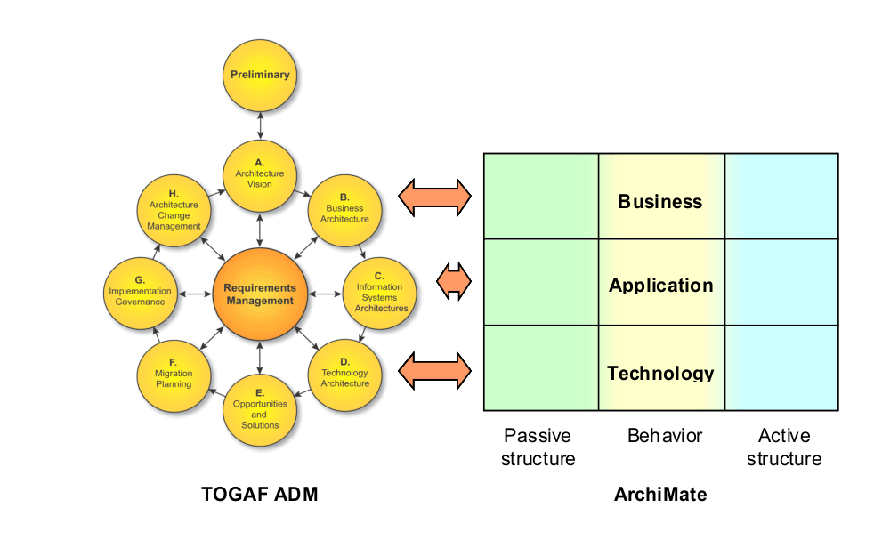
Vertical EA Method: Archimate

Slide 14
About Archimate
An Open Group EA method supported by tool vendors, consulting firms and businesses
Vertical EA method: supports different concepts and aspects across different layers – corresponding to TOGAF views
Enables modeling throughout the TOGAF Architecture Development Method
ArchiMate Core corresponds with the three main architectures as addressed in phases B, C & D in the TOGAF® ADM
The extensions to the Core closely correspond with the main aspects to be addressed in the Preliminary phase, Phase A and the Central Requirements management repository, as well as Phases E, F, G and H

Slide 15
TOGAF layers through Archimate
Business layer
Application layer
Technology layer

Slide 16
Linking layers through Services
Consumers
Business layer
Archimate
[M. Lankhorst et al. Enterprise Architecture
at Work: Modelling, Communication and
Analysis (2nd Ed). Springer-Verlag, 2009]
Business services
Business processes
Application services
Primary application
components
Application layer
Internal application
services
Application components
Supporting application
components
Platform/infrastructure services
Technology layer
Platforms/infrastructure

Slide 17
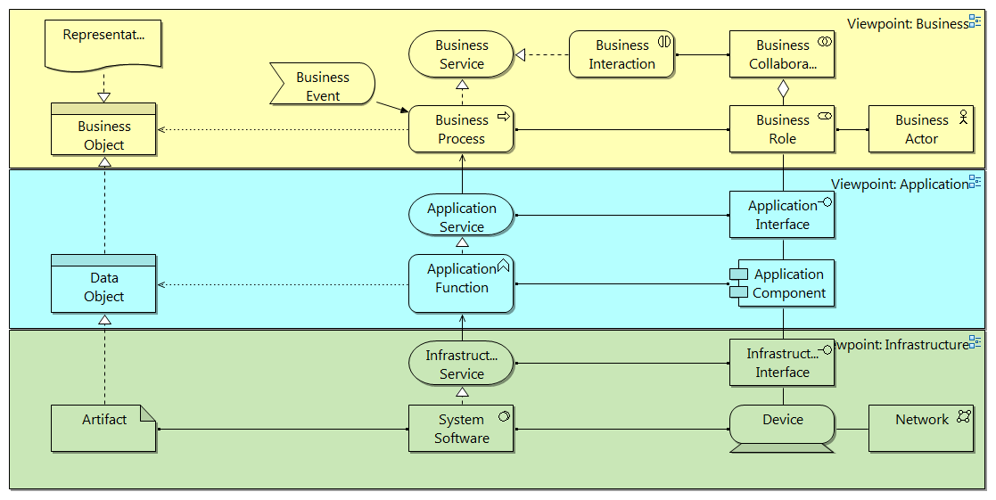
Overview of Archimate: Layers and Key Concepts
B Layer
Support
A
Layer
T Layer
Structure
Behavior
Resource
Notes:
API = Application Interface

Slide 18
Agenda
Different aspects and layers of enterprise architecture
Archimate business layer modelling
Archimate IT application layer modelling
Archimate IT infrastructure layer modelling

Slide 19
Business layer modelling
Business Capability Map
Capture organizational context
Organization structure
Organizational collaborations
Capture high-level process context
Value streams (high-level process map)
Integrated scenarios (more detailed process map) that include services, processes, key business objects, resources
Capture product bundles
Capture high-level information
Capture BO
Capability
alignment
to models

Slide 20
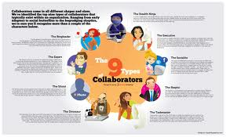
Business layer modelling
Organization context:
Organisational structure – actors, roles, hierarchy
Collaborations with partners inside and outside organisation
Key business functions and information flow

Slide 21
Business layer modelling
High-level process:
Key services and processes:
Captures value stream maps (process blocks)
integration scenarios (services, processes, events and other details)
Key partners and stakeholder interactions
Key business objects used

Slide 22
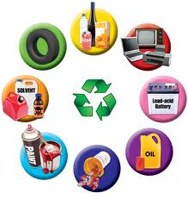
Business layer modelling
Product:
Bundling of consumables targeted for customers
What: services, other products and documents are involved
Not how: does not expose processes, applications, infrastructure details

Slide 23

Business layer modelling
Information context:
Key business objects (i.e. information records)
High level structure: relationships with business objects, which ones they they are a special part of
Whether they are contained or referred to through other business objects

Slide 24
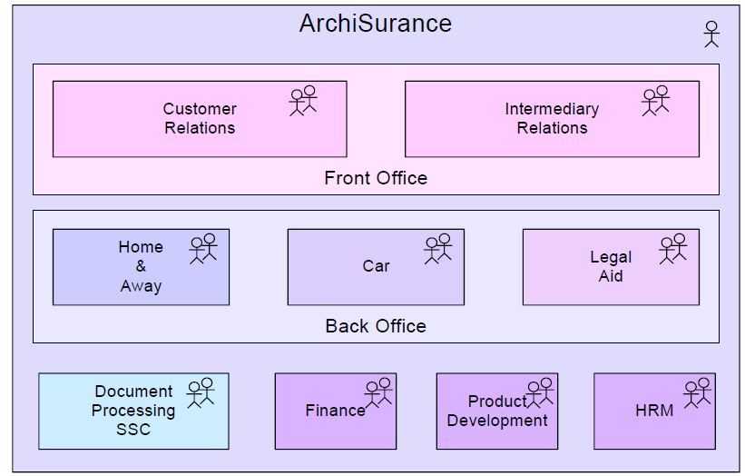
Business layer modelling: org. context
Organisational structure
Business
actor

Slide 25
Explanation of model
ArchiSurance is an organization, modelled as an actor
It consists of 5 first-level organizational units modelled as actors:
Front Office, Back Office, Document Processing SSC, Finance, Product Development and HRM
Two of these organizational units each consist of other, second-level organizational units:
Front Office: Customer relations, Intermediary relations
Back Office: Home & Away, Car and Legal Aid
Notes:
NOT NECESSARY

Slide 26
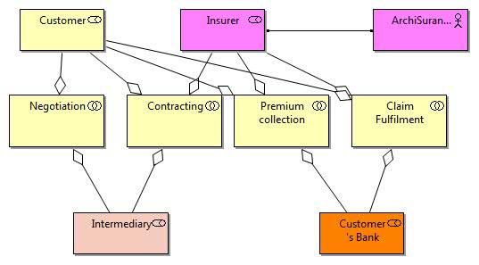
Business layer: org. context
Organisational collaborations
Business
role
Business
actor
Assigns
Uses, but does
not contain
Business
Collaboration –
specific area of
analysis or
understanding
Notes:
One person can have different roles

Slide 27
Explanation of model
The “big picture” of collaborations between a number of business partners and customers on the basis of the roles they play
ArchiSurance assigned as an Insurer role and other roles Customer, Customer’s Bank and Intermediary without the actors they’re assigned to
Customer and Intermediary collaborate for Negotiations (for insurance offers from different insurers)
Customer, Intermediary and Insurer collaborate for Contracting (for the customer to obtain a specific insurance offer from an insurer)
The Customer, Insurer and Customer’s Bank collaborate for Premium Collection (for setting up the process regular payments from the customer to the insurer for the insurance offer)
The Customer, Insurer and Customer’s Bank collaborate for Claim Fulfillment (for the customer to get money for a specific claim)
Notes:
NOT NECESSARY

Slide 28
Business layer: org. context
Business actor
Human resource entity delivering value to customers and internal parts of the organisation, and collaborating with partners and stakeholders
Permanent or long-term status within organisation
Corresponds to person or group
Hieratically composed to reflect org. structure
Capture for “end-point” delivery – directly associated with services and products, not processes (unlike BPM techniques)

Slide 29
Business layer: org. context
Business role
Logical resourcing need for product and service delivery
A business actor performs in an organisation in a role, i.e. business actor has assigns relationship with business role
Allows operational planning without direct reference to org. structure – roles change less than actors
A business actor can be assigned multiple roles and a role can have multiple actors assigned to it
Business processes/functions support business roles through the realises relationship (see below)
Supports outsourcing and collaborations with external partners

Slide 30
Business layer: org. context
Business collaboration
(Possibly temporary) combination of two or more roles resulting in collective behaviour (interactions) in a particular context
Unlike business actor’s composition (containing, black diamond) of roles, it aggregates roles but does not contain them (white diamond), as roles can be part of other collaborations

Slide 31
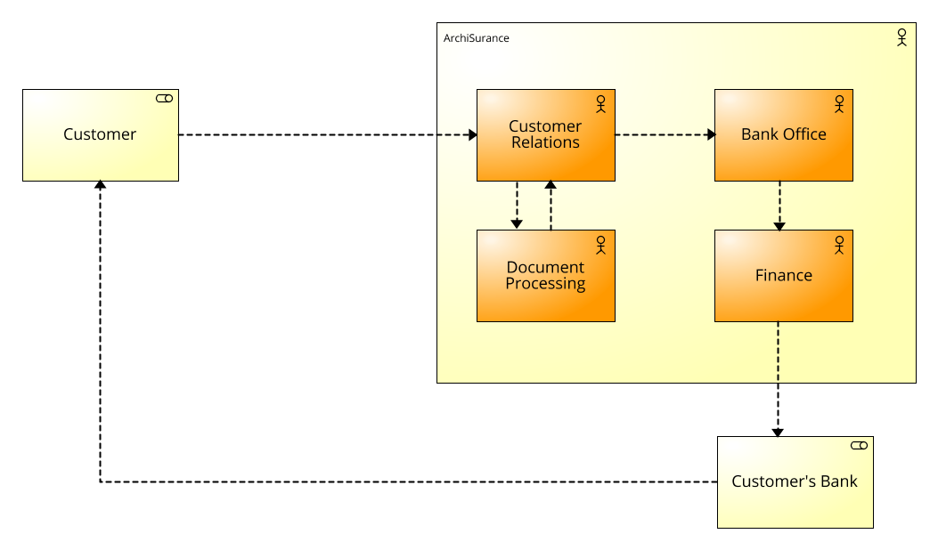
Business layer: org. context
Drill-down org. collaboration – Claim Fulfillment
Role
expansion
expands
assigned
actor
and its
roles
Assigns
Information
flow

Slide 32
Explanation of model
The “big picture” of a set of interactions between a Customer role and the ArchiSurance org. units (for claims handling)
The Customer contacts the ArchiSurance Customer Relations unit (for lodging a a claim)
The Customer Relations interacts with the Document Processing unit (to retrieve information about the customer and store information about the claim)
The Customer Relations unit interacts with the Back Office (to process the claim)
The Back Office interacts with the Finance unit (to process payment for successful claims)
The Finance unit interacts with the Customer’s Bank (to advance payment)
The Customer’s Bank interacts with the Customer (to notify of payment)

Slide 33
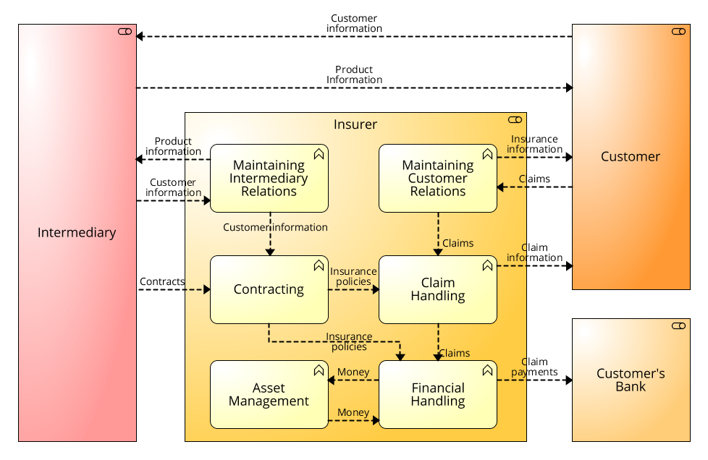

Business layer: org. context
Drill-down org. collaboration – view flows against business functions
Business
function
How are
Flows associated
with functions?

Slide 34
Explanation of model
Alternative depiction of claims processing, compared to the previous model
This time all parties are expressed as roles, so that the same model could apply for different actors (different insurance providers)
AchiSurance is replaced by the Insurer role
All external interactions remain the same
Internal interactions are shown between business functions (similar to business capabilities): e.g.. Contracting, Claim Handling
Different business processes could be aligned because business functions are general

Slide 35
Business layer: org. context
Business function
Unit of internal behaviour that grouped for planning purposes
Main use is grouping business processes and activities for required skills, knowledge, resources
Can used as basis for organisation capability map alignment with operations
Functions can be composed of other functions
Strict planning of operations through functions (and not business services and processes) leads to stove-pipes

Slide 36
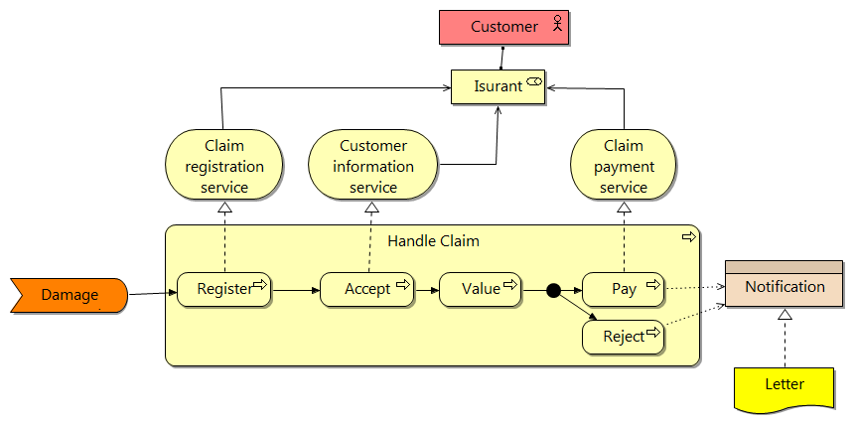
Business layer: process context
Value stream map – integrated scenarios
Assigns
Business actor
Business
service
Uses
Business role
Business
event
Realises
Business object
Business
process
Triggering
Junction
in process
Access
Representation

Slide 37
Explanation of model
A part of a value stream broken down into an integrated scenario
The value stream part being analysed is: Handle Claim
The Handle Claim is broken into the following process flow: Register, Accept, Value and Pay/Reject)
An event triggers the process: Damage
The process supports three services: Claim registration Service (supported by Register), Claim information service (supported by Accept), and Claim payment service (supported by Pay)
The three services are used by an Insurant role which is assigned to a Customer actor
A part of the process involves a split in its path: either to Pay or Reject
The process produces a Notification business object sent through a Letter

Slide 38
Business layer: process context
Business service
Externally visible functionality delivered by an organisation internally (e.g. shared services) and externally (to market)
Focus on key capabilities - value delivered, typically conveyed through information, goods and other physical artefacts
Shields enablers such as business processes – service information principle
Subject to delivery constraints, e.g. time, place, price, rewards, rights, penalties – service level agreements between providers and consumers
Delivered through roles – a business role uses one or more services

Slide 39
Business layer: process context
Business process
A collection of causally related internal behaviour – how organisations plan and execute their internal operations
Aimed at supporting the delivery of products and services
Support business services through realises relationship
Can be aggregated of other business processes and activities (elementary forms)
Triggered by business events
Access business objects for read/write
Use of business services or business actors/roles are not captured: enterprise architecture capture of business processes mostly used for planning, not orchestration

Slide 40
Business layer: process context
Business event
Something that happens internally or externally and influences an organisation’s operations (business processes, functions and interactions)
Used for capturing triggers (to start processes), although other types of events have different effects, e.g. interrupting a process (note not modelled at in business process in a vertical EA)
Events can integrate a number of business processes – causal dependency which trigger processes and arise from them

Slide 41
Business layer: process context
Business interface
The way a business role interacts internally or externally in an organisation, otherwise known as a communication channel
Examples include mail, telephone, Web or mobile channel
Note, business channels, e.g. call centres, service desks, are modelled as business actors

Slide 42
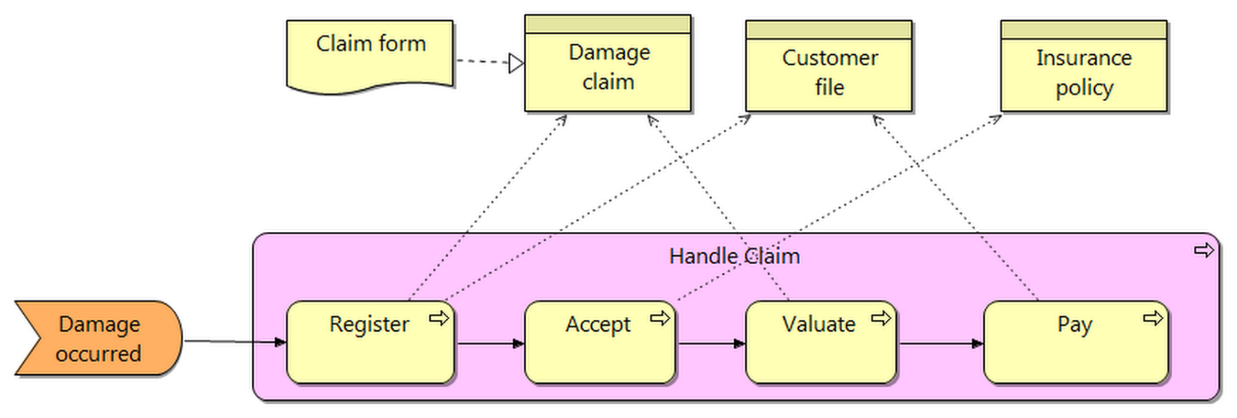
Business layer: process context
Integration scenarios – process and data flow
Business
object

Slide 43
Explanation of model
An integrated scenario for Handle Claim, showing how the control and data flows
The Register process accesses two business objects: Damage claim and Customer file; the Access process accesses Insurance policy; the Valuate process accesses Damage claim; The Pay process accesses Customer file.
Claim form realises Damage claim

Slide 44
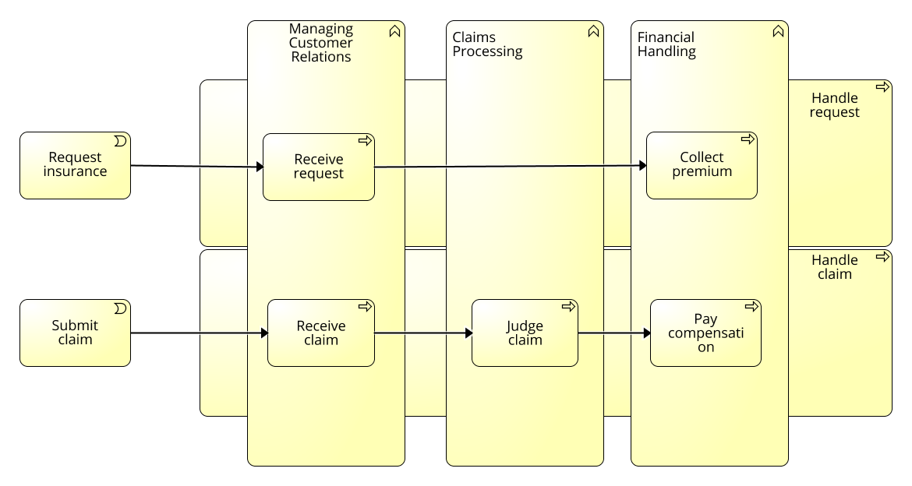
Business layer: process context
Integration scenarios - aligning business process to business functions

Slide 45
Explanation of model
The alignment of business processes with business functions
Business functions (Managing Customer Relations, Claims processing, and Financial Handling) are aligned across different processes (Handle Request and Handle Claim):
The Managing Customer Relations business function is aligned to Receive Request from Handle Request process and Receive Claim from Handle Claim process
The Claims Processing business function is aligned to Judge claim from Handle Claim process
The Financial Handling business function is aligned to Collect premium from Handle Request process and Pay compensation from Handle Claim process

Slide 46
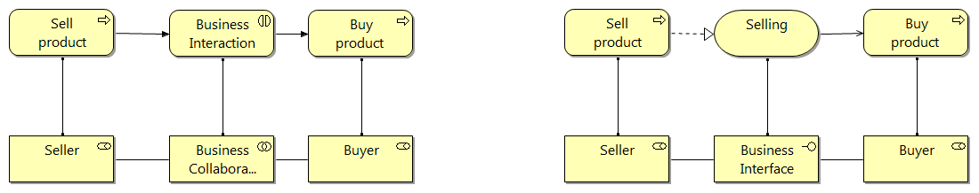
Business layer: process context
Integrated scenarios - external business interactions
Business
service
Business
interaction
Business collaboration
Business interface

Slide 47
Explanation of model
The model illustrates how an interaction and collaboration can be used to model a business transaction and how the same situation can be modelled with the service and interface concepts. These two alternatives can be seen as two views, a symmetrical (‘peer-to-peer’) view and an asymmetrical (‘client–server’) view, of the same process. In the former view, the buyer and seller perform collaborative behaviour to settle a transaction, while in the latter view the selling of a product is considered to be a service that the seller offers to the buyer.

Slide 48
Business layer: process context
Business interaction
Unit of behaviour performed in collaboration by two or more business roles
Occur through business processes, although they are available through business roles:
Collaborating roles supported by their business processes may have interactions to automatically or semi-automatically integrate the processes
To facilitate reuse, the interactions may be exposed as a business service:
The business process assigned to one role is used to realise the business service, which is used by the business process assigned to the other role

Slide 49
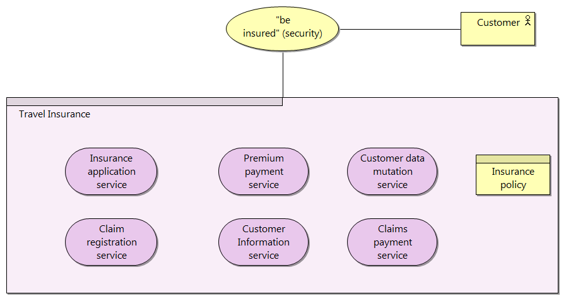
Business layer: process context
Product bundling
Business
product

Slide 50
Explanation of model
A typical insurance product of ArchiSurance. The value to the customer of an insurance is typically the added security it provides.
The insurance product constitutes six services (Insurance application service, Premium payment service, Customer data mutation service and etc.)

Slide 51
Business layer: process context
Business product
Coherent collection of services or other products offered as a whole internally or externally
Services could be business, application or technology services
Buying product gives customer a right to use associated its bundled services and products
Agreements between provider and consumer are drawn up in a business contract associated with the product
Portfolio management of product types is important factor in organisational planning and enterprise architectures, as products are more stable than services, processes, functions

Slide 52
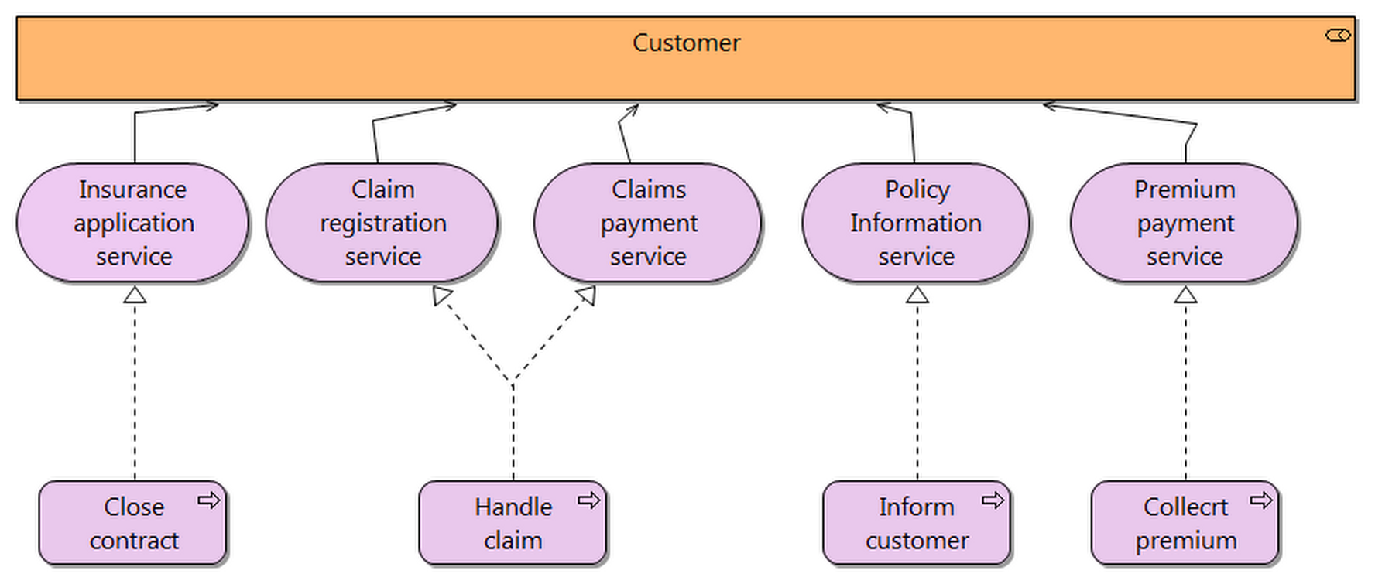
Business layer: process context
Integration scenarios - Realisation

Slide 53
Explanation of model
The model shows the realisation of business services by ArchiSurance business processes.
There are five business services that constitute the travel insurance product, and they are realised by business processes
Insurance application service is realised by Close Contract.
Claim registration service and Claims payment service is realised by Handle Claim
Customer information service is realised by Inform Customer
Premium payment service is realised by Collect Premium

Slide 54
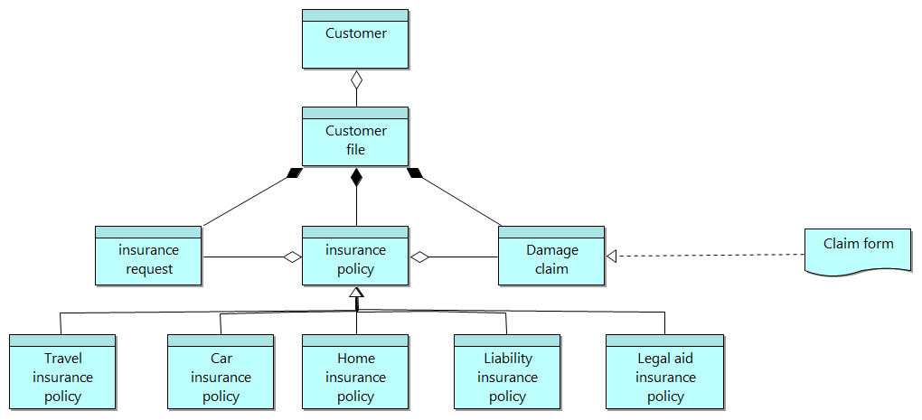
Business layer: information context
Enterprise master data management
Business
object
Notes:
Black diamond stands for a containment (ie. Customer file contains Insurance Request, Insurance Policy and Damage Claim) (if Customer file is deleted, anything it contains will be eliminated)
White Diamond stands for relation btw things that refer to each other

Slide 55
Explanation of model
The model presents the most important business objects of ArchiSurance. Some of these are used in the Handle Claim business process.
Customer aggregates customer file, which is composed of Insurance request, Insurance policy, and Damage claim.
There are five (Travel, Car, Home, Liability and Legal aid insurance policty) difference kinds of Insurance policy and they are specialisation of Insurance policy

Slide 56
Business layer: information context (cont’d)
Business object
A collection of data that logically represents an information artefact of interest (e.g. customer, purchase order, bank account)
Accessed by a business process, service, interaction or event
Can either be an administrative (used internally) or message object (used to exchange information with external parties)
Often forms the basis for structuring core parts of business service and application services
Has one or more perceptible forms that apply to different contexts, i.e. has a Representation

Slide 57
Agenda
Different aspects and layers of enterprise architecture
Archimate business layer modelling
Archimate IT application layer modelling
Archimate IT infrastructure layer modelling

Slide 58
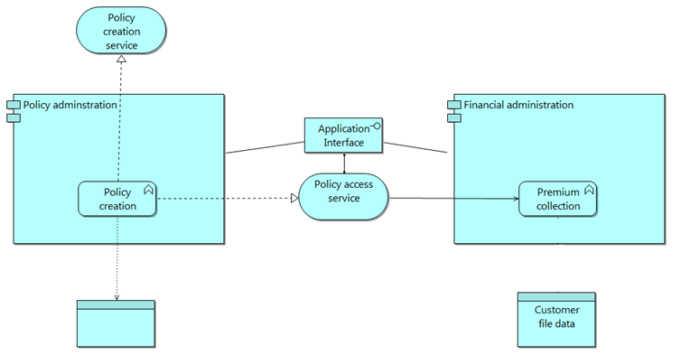
Application layer
Integrated application scenario
Application service
Application component
Application interface
Application function
Application service
Application data object
Policy data
Notes:
In Archimate
Business Layer
Application Layer
Presentation Layer [1. Abstract Device Type, 2. Application Domain] which contains a series of interface objects
Business Object Layer
Data Access
Database Access
Technology Layer
Platform (OS, Database Management System[MySQL and OracleDB], Security System[authentication and authorization], Browser, Content Management, Messaging)
Infrastructure (Server, Storage, Network, etc.)

Slide 59
Explanation of model
A typical example of an application layer and it illustrates the use of the central concepts
The application function: Policy creation is implemented by the application component: Policy administration, and the function realises the application services: Policy creation and Policy access. The function produces and uses the application data object: Policy data.
The application components: Policy administration and Financial administration interact through the application interface, which is assigned to the application service: Policy access.

Slide 60
Application layer: (cont’d)
Application component
A logical component of a software application, which ideally should be used for different business contexts and requires, and which could be considered independently deployable and reusable
Covers complete software applications, sub-applications or modules of applications
Should correspond to logical software design components (as modelled in design techniques like UML)

Slide 61
Application layer: (cont’d)
Application collaboration
A configuration of two more applications that interoperate (similar to collaborations in UML)
Application interface
The “endpoint” through which an application component’s functionality is accessed
Allows operations (including their data inputs and outputs) of the application to be accessed
Application-to-application interface correspond to application programming interfaces (API)
Business-to-application interfaces (user interfaces)
Provided interface vs. required interface

Slide 62
Application layer: (cont’d)
Application data objects
Coherent, self-contained piece of information suitable for automated processing (similar to UML classes)
Can be a “wrapper” for data from one or more structured or unstructured data sources
Can compose/aggregate other application data objects
Allowable actions understood from a CRUD perspective (Create, Read, Update, Delete)
Can expose allowable order of actions in its lifecycle (e.g. UML State Diagrams, SAP Business ByDesign Status&Action Management models)

Slide 63
Application layer (cont’d)
Application service
an externally visible unit of functionality, provided by one or more components, exposed through well-defined interfaces, and meaningful to the environment.
Application function
a coherent unit of internal behaviour of an application component.
Application interaction
a unit of behaviour performed by a collaboration of two or more application components.

Slide 64
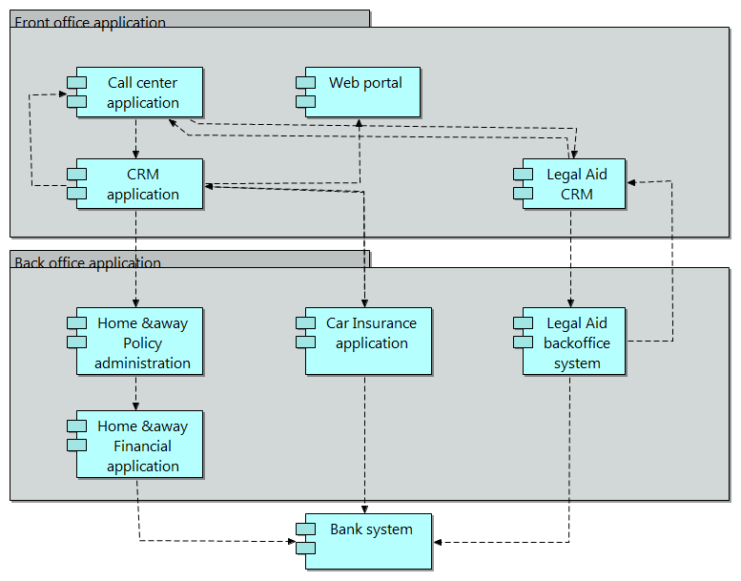
Application layer (cont’d): applications and information flow

Slide 65
Explanation of model
Information flow between the front- and back-office applications of ArchiSurance. For example, data is exchanged between the CRM application at the front and the Car Insurance application at the back.
It is clear that the back office is structured according to the different types of products, whereas the front office is already more integrated.

Slide 66
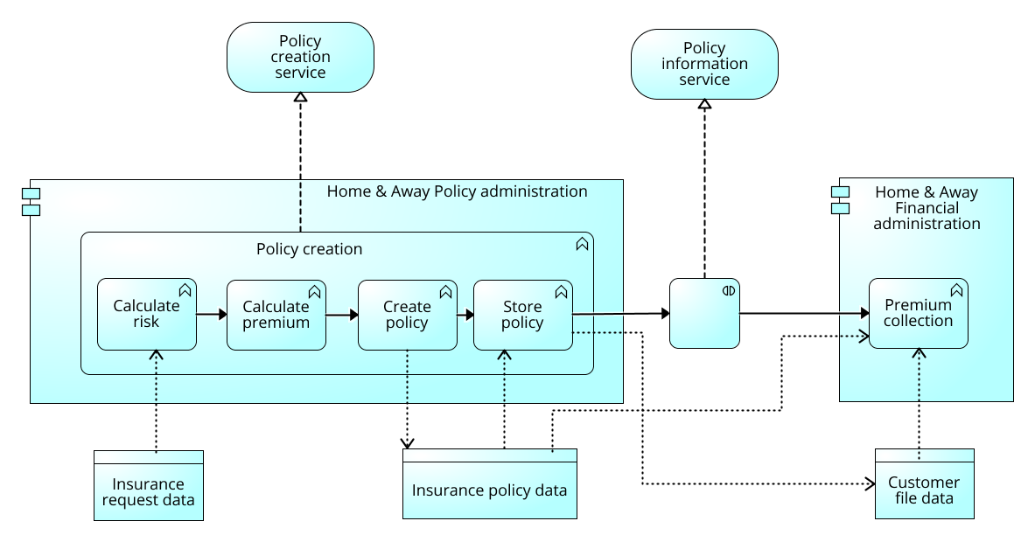
Application layer (cont’d)
Application Behaviour Viewpoint

Slide 67
Explanation of model
The Application Behaviour viewpoint describes the internal behaviour of an application or component, for example, as it realises one or more application services. This viewpoint is useful in designing the main behaviour of applications or components, or in identifying functional overlap between different applications.
The model shows part of the behaviour of the Home & Away Policy administration. The individual application functions are chained together and collectively realise the Policy creation application service. The communication with the Financial administration takes place in an interaction that realises the Policy information service.

Slide 68
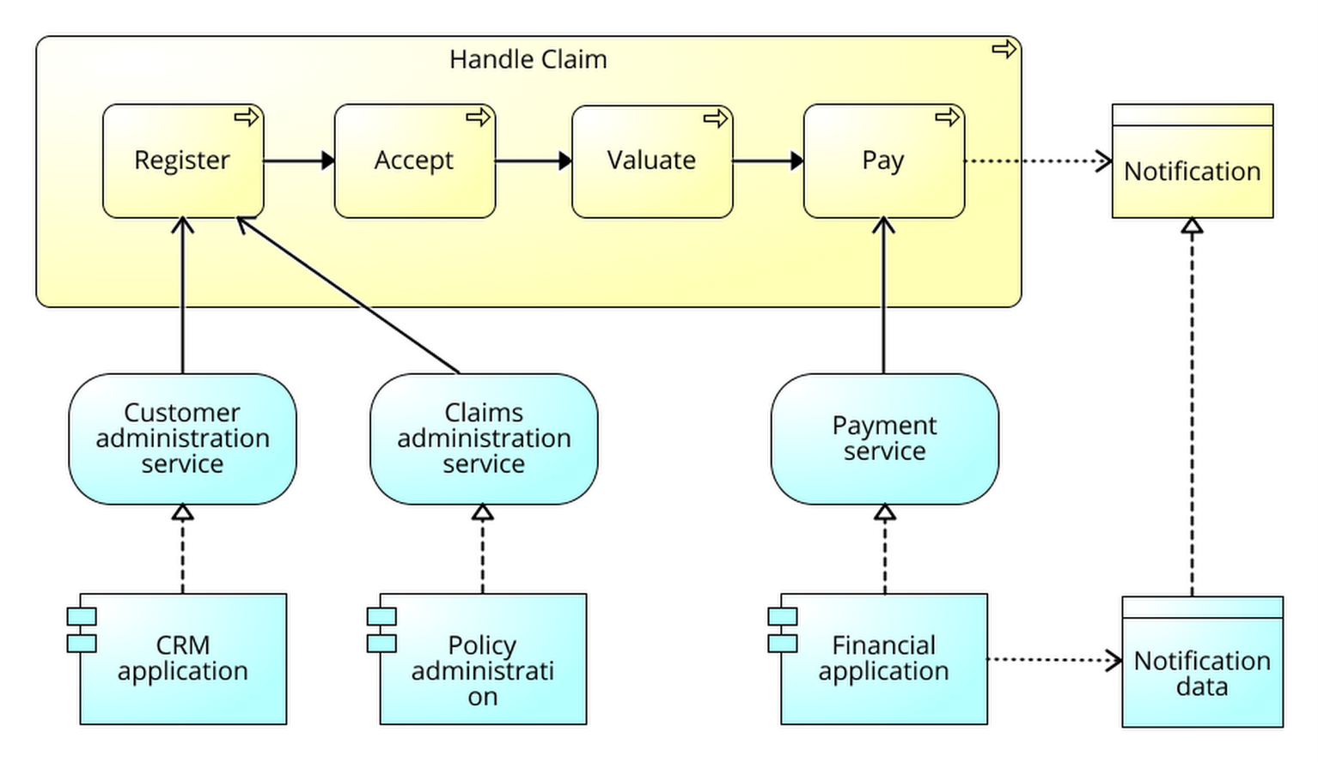
Application layer (cont’d)
Business – application alignment
Business
layer
Application
layer

Slide 69
Explanation of model
The model shows the link between the application layer and the business layer.
Application services can be used by business behaviour and application interfaces are used by business actors roles, i.e., there is a support relation between the application and business layers. For example, the business behaviour: Register uess the Customer administration and Claims administration service.
Data objects can realise business objects; this means that a data object is an electronic representation of the business object, i.e., there is an implementation relation between the application and business layers. For example, the data object: Notification data realises the business object Notification.

Slide 70
Agenda
Different aspects and layers of enterprise architecture
Archimate business layer modelling
Archimate IT application layer modelling
Archimate IT infrastructure layer modelling

Slide 71
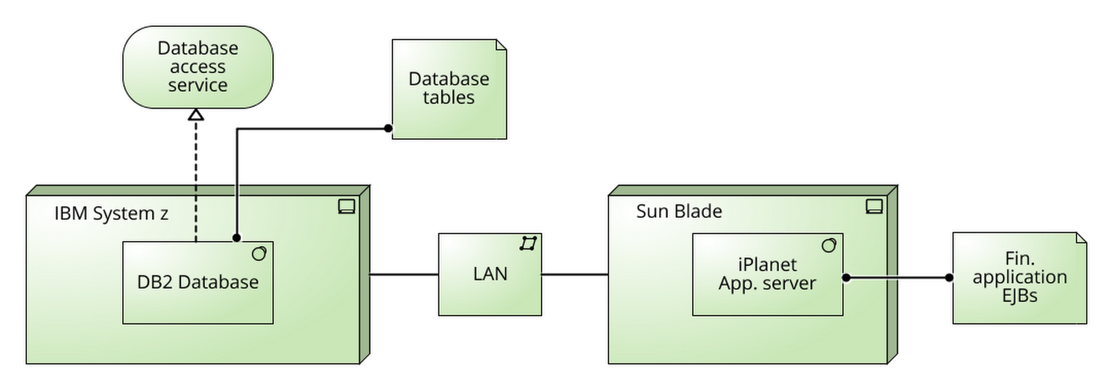
Infrastructure layer
Infrastructure model – application platform
Infrastructure
service
Artifact
Association
System
software (platform
software)
Network
Infrastructure node (server)

Slide 72
Explanation of model
The model shows a typical example of an infrastructure layer and it illustrates the use of the central concepts.
The system software: DB2 Database is hosted in the node: IBM system z, and it realises the infrastructure service: Database access and produces the artifact: Database tables. The nodes: IBM system z and Sun Blade are associated with LAN.

Slide 73
Infrastructure layer: (cont’d)
Infrastructure node
A logical computational resource for deploying artefacts (similar to “node” concept in UML 2.0)
Typically corresponds to servers
A node can have sub-nodes
Infrastructure interface
A point of access where infrastructure services offered by an infrastructure node can be accessed by other
Infrastructure device
A physical computation resource for deploying and accessing artefacts

Slide 74
Infrastructure layer: (cont’d)
Communication path
A logical link between two or more nodes through which these nodes can interact
Network
A physical communication medium between two or more devices
Artefact
A physical piece of information that is used or produced in the software development process or by deployment and operation of a system (similar to “artefact” concept in UML 2.0)

Slide 75
Infrastructure layer: (cont’d)
System software
A particular type of infrastructure node, used to model environment on which software artefacts run
Examples: operating system, an application server (e.g. JEEE/J2EE), a database management system, BPM system, COTS like enterprise resource planning (ERP) system
Infrastructure service
Externally visible unit of functionality, provided by one or more nodes, exposed through well-defined interfaces

Slide 76
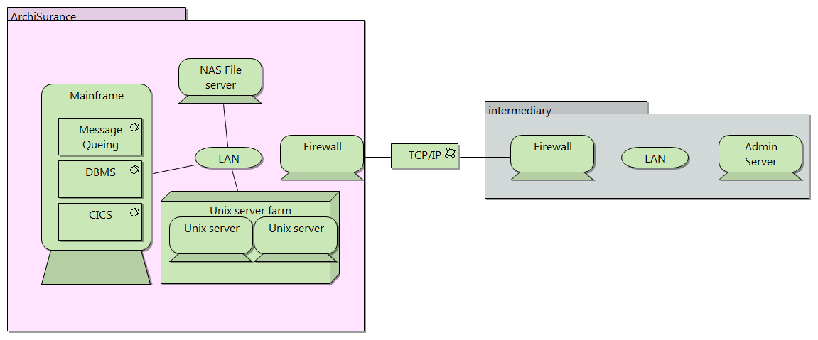
Infrastructure layer (cont’d)
Infrastructure model: infrastructure viewpoint

Slide 77
Explanation of model
The Infrastructure viewpoint comprises the hardware and software infrastructure upon which the application layer depends. It contains physical devices and networks, and supporting system software such as operating systems, databases, and middleware.
The model shows the physical infrastructure of ArchiSurance and its intermediaries.

Slide 78
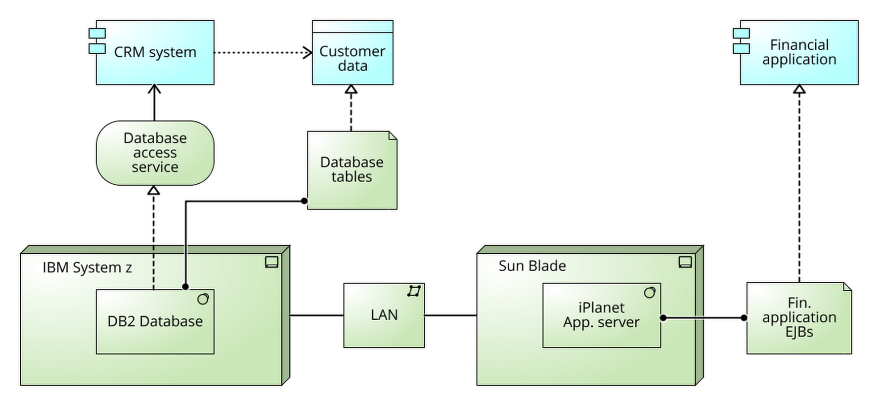
Infrastructure layer (cont’d)
Infrastructure – application alignment
Application
layer
Infrastructure
layer

Slide 79
Explanation of model
The technology layer and the application layer can also be linked very easily. Similar to business-application alignment, two types of relations provide this link:
Infrastructure services can be used by application functions and infrastructure interfaces are used by application components, i.e., there is a support relation between the technology and application layers. For example, the infrastructure service: Data access is used by the application component: CRM system
Artifacts can realise data objects and application components, i.e., there is an implementation relation between the technology and application layers. For example, the artifact: Database tables realises customer data and Financial application EJBs implements the application component: Financial application.
Artifacts play a central role in showing how ‘logical’ application components are realised by ‘physical’ components (modelled as artifacts).

Slide 80
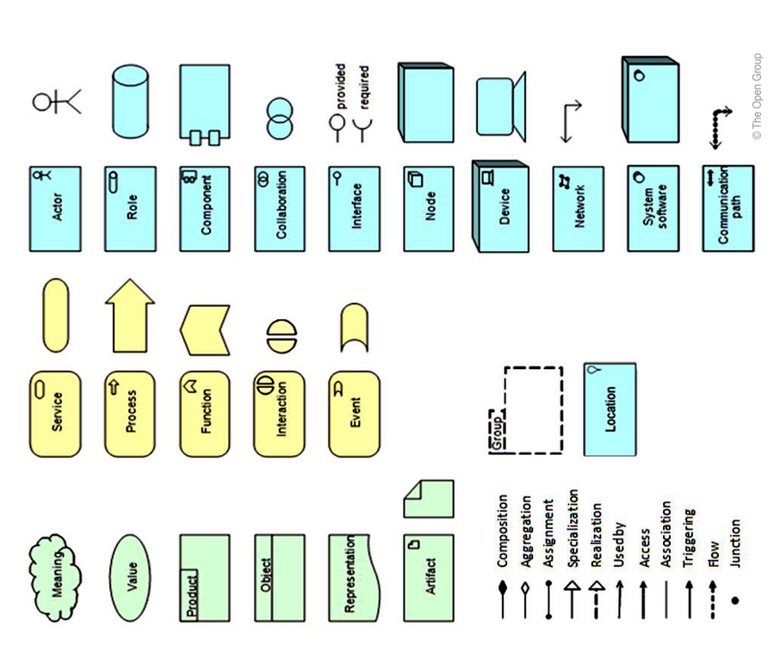
Summary of Archimate Concepts and Relationships

Slide 81

Questions

Slide 82

Prof. Alistair Barros
Smart Services CRC Chair for Services Science and Computing
School of Information Systems
Faculty of Science and Engineering
Queensland University of Technology
Email: alistair.barros@qut.edu.au
Skype: alistairbarros
Web: http://www.alistairbarros.com

